Slide 1
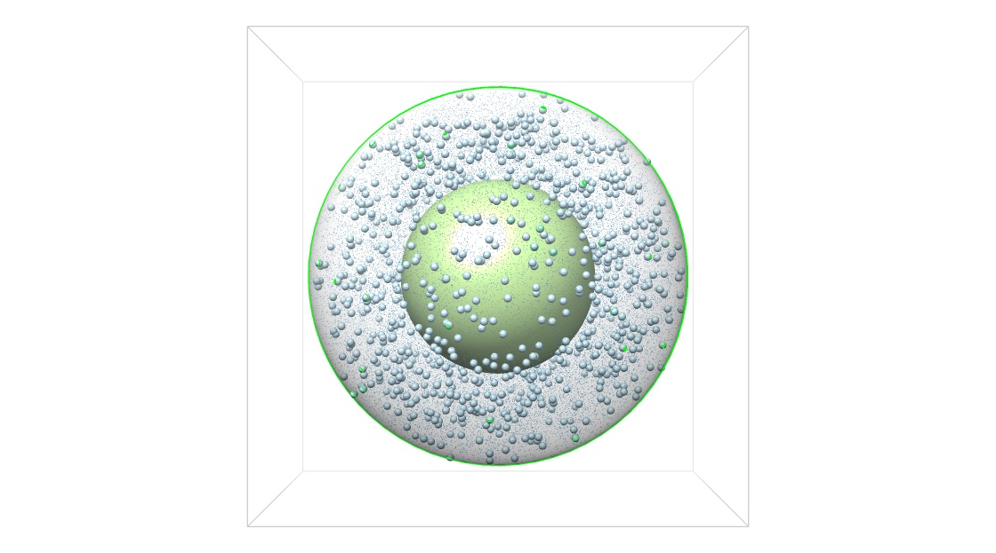





Representing a dynamic system of interacting parts
a. parts
b. interactions
c. dynamics
F(Xn)
Xn
R

Slide 2
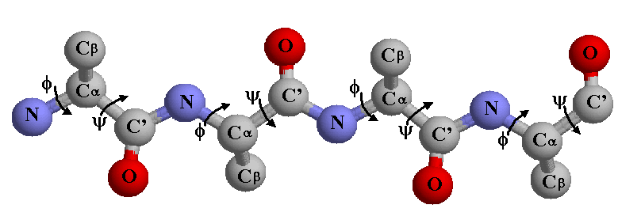
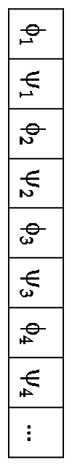
I. Parts (configuration space)
DoF vector

Slide 3
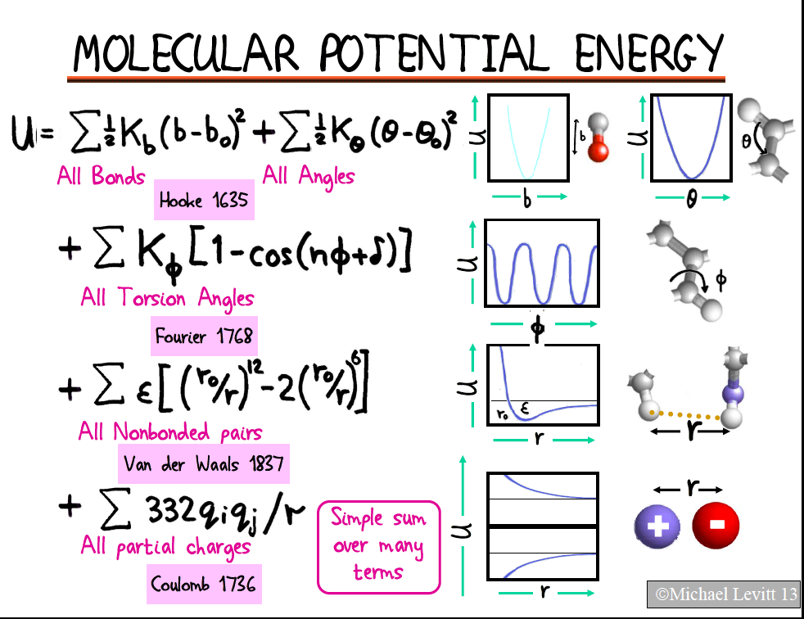
II. Interactions

Slide 4
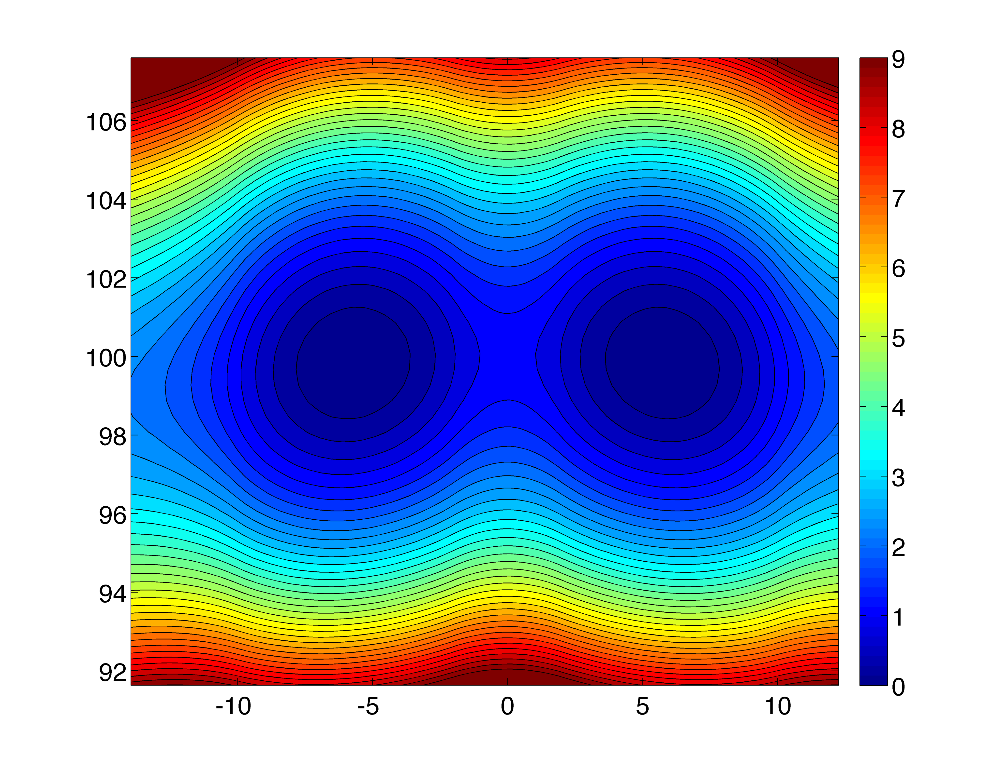
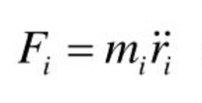
III. Dynamics – rules for updating a system’s configuration over time due to interacions
F(r0)
r0

Slide 5
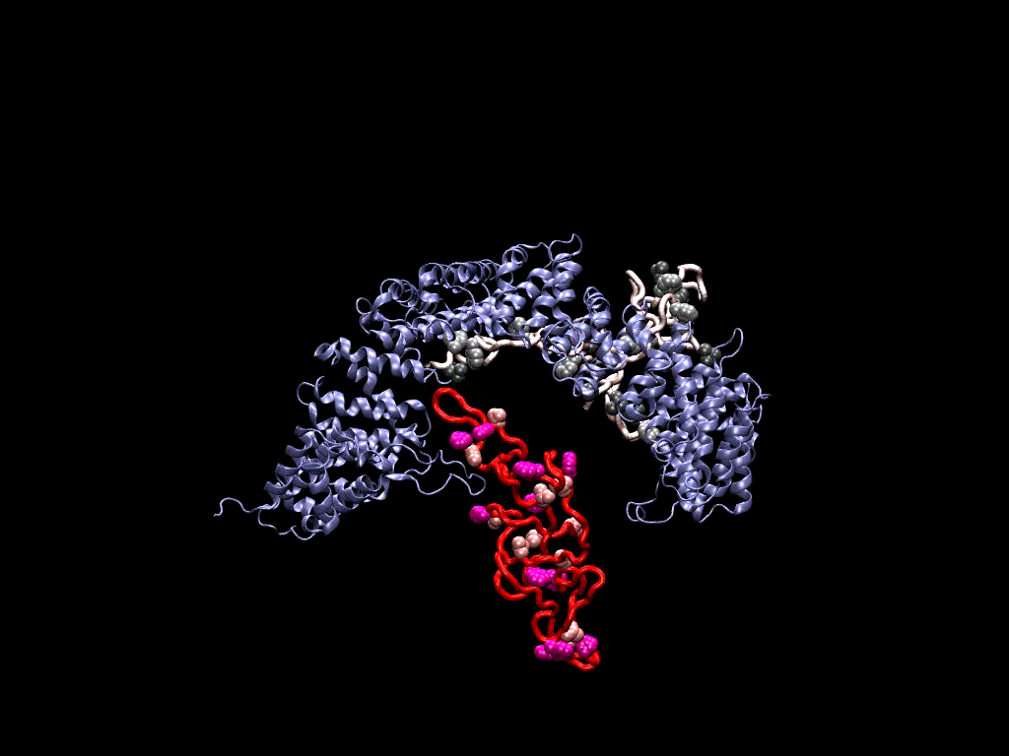
A molecular dynamics simulation of interacting proteins
Computational challenge:
10⁴s of atoms
10⁵s of water molecules

Slide 6
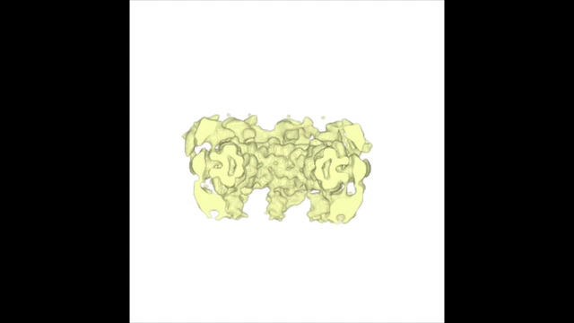
Larger systems: transport through nuclear pore complexes
cytoplasm
Computational challenge:
10⁷s of atoms
10⁸s of water molecules
nucleus

Slide 7
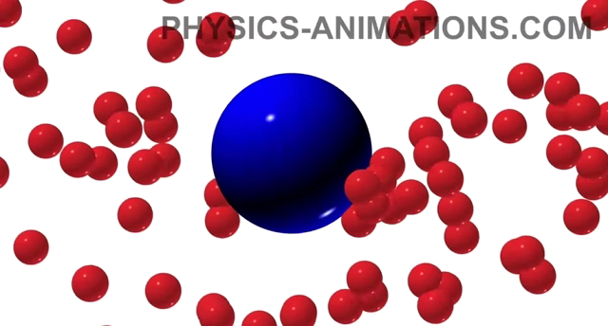
Solution I – reduce the dimensionality of C-space, run much faster, and save the day (but how?)
Brownian motion: collisions with liquid/gas molecules are random, increasing with temperature (proof: the law of large numbers)

Slide 8
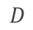
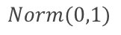
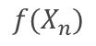
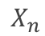
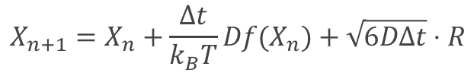
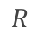
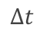
Brownian dynamics: a random walk in the energy landscape (aka, a Wiener process)
$$X_{n+1}=X_{n}+\frac{Δt}{k_{B}T}Df(X_{n})+\sqrt{6DΔt}⋅R$$
𝑓
particle configuration at time step n
sum of all forces acting on particle
random diffusion vector of magnitude ~
diffusion coefficient
time step
$$X_{n}$$
$$f(X_{n})$$
$$R$$
$$Norm(0,1)$$
$$D$$
$$Δt$$
deterministic
𝑓(𝑥0)
𝑓(𝑥0)+R
X0
R
stochastic

Slide 9
Brownian dynamics: a random walk in the energy landscape (aka, a Wiener process)
$$X_{n+1}=X_{n}+\frac{Δt}{k_{B}T}Df(X_{n})+\sqrt{6DΔt}⋅R$$
𝑓
particle configuration at time step n
sum of all forces acting on particle
random diffusion vector of magnitude ~
diffusion coefficient
time step
$$X_{n}$$
$$f(X_{n})$$
$$R$$
$$Norm(0,1)$$
$$D$$
deterministic
$$Δt$$
𝑓(𝑥1)
X1
𝑓(𝑥1)+R
R
stochastic

Slide 10
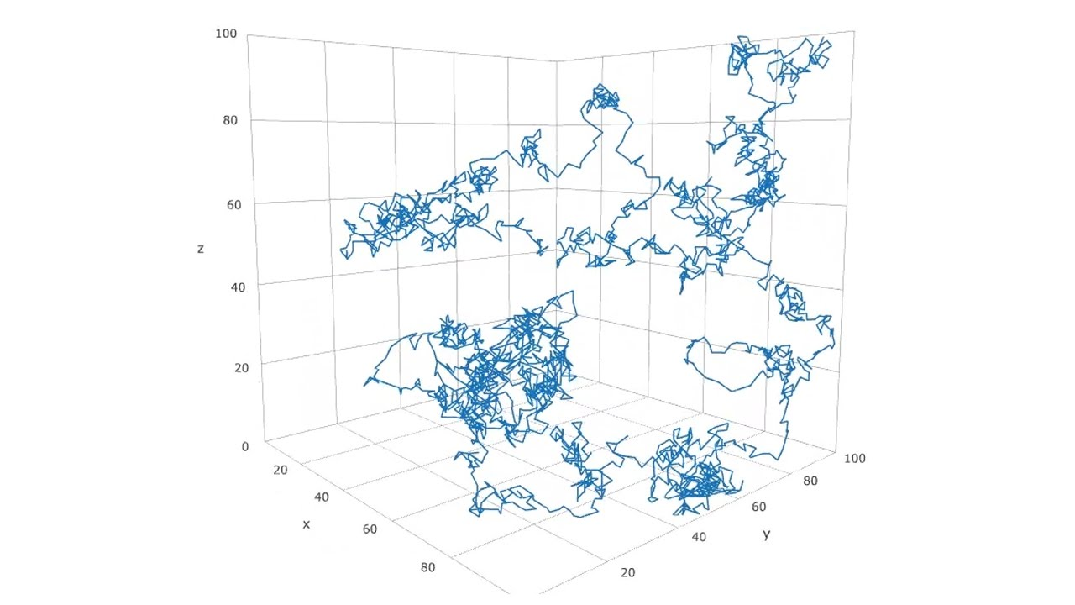
How much do we move through random collisions? Random walk theory

Slide 11
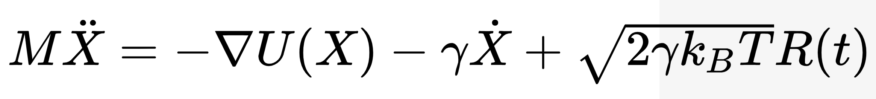
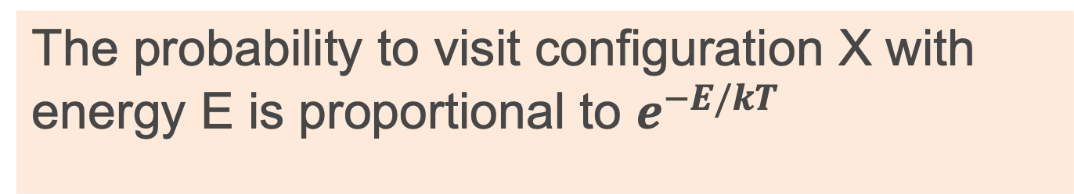
What distribution do Langevin dynamics and Brownian dynamics converge to?
0
Zero mean acceleration
velocity (damped by gamma)
Stochastic process (Brownian motion)
Force field
The probability to visit configuration X with energy E is proportional to $e^{−E/kT}$
Boltzmann

Slide 12
Is it enough? BD rids us only of the water molecules
cytoplasm
Computational challenge:
10⁷s of atoms
10⁸s of water molecules
nucleus

Slide 13
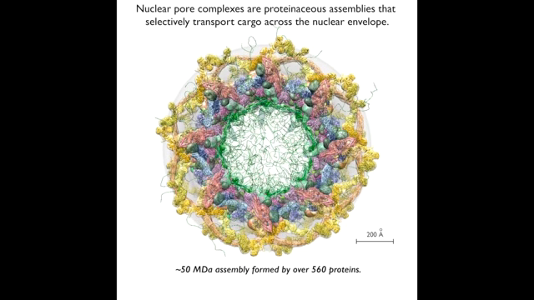
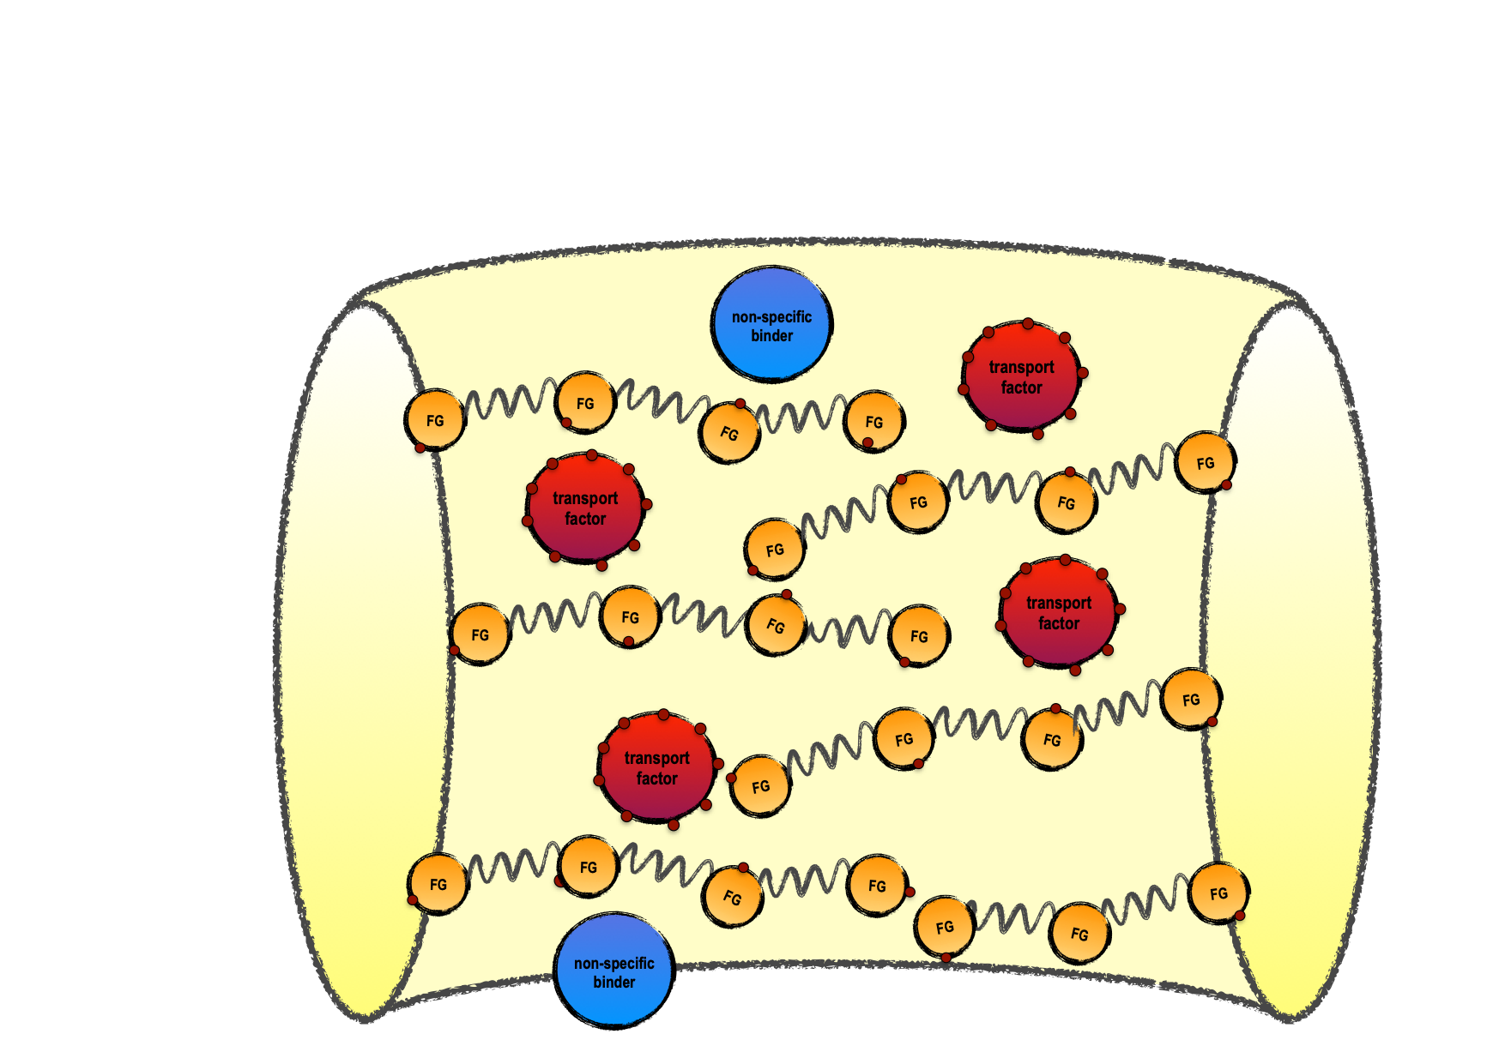
Solution II – coarse graining
Reducing the dimensionality of the configuration space by choosing a coarse spatial representation
Kim et al, Nature 2018

Slide 14





a. Representation of system’s parts
embedded in a high-dimensional configuration space
FG repeats:
Configuration/phase space describing system's coordinates and moments: 𝑥 ∈ ℛ^{𝒹}
Dimensionality reduction by coarse-graining: ~10⁸ atoms → ~10⁴ particles
Scaffold:
cargo- carrying NTRs:
inert proteins:
Timney*, Raveh* et al., 2016, Journal of Cell Biology
Kim et al., Nature 2018
Raveh et al. 2019, manuscript in preparation

Slide 15
a. Representation of system’s parts
embedded in a high-dimensional configuration space
The strings of beads model
Configuration/phase space describing system's coordinates and moments: 𝑥 ∈ ℛ^{𝒹}
Dimensionality reduction by coarse-graining: ~10⁸ atoms → ~10⁴ particles
Timney*, Raveh* et al., 2016, Journal of Cell Biology
Kim et al., Nature 2018
Raveh et al. 2019, manuscript in preparation

Slide 16
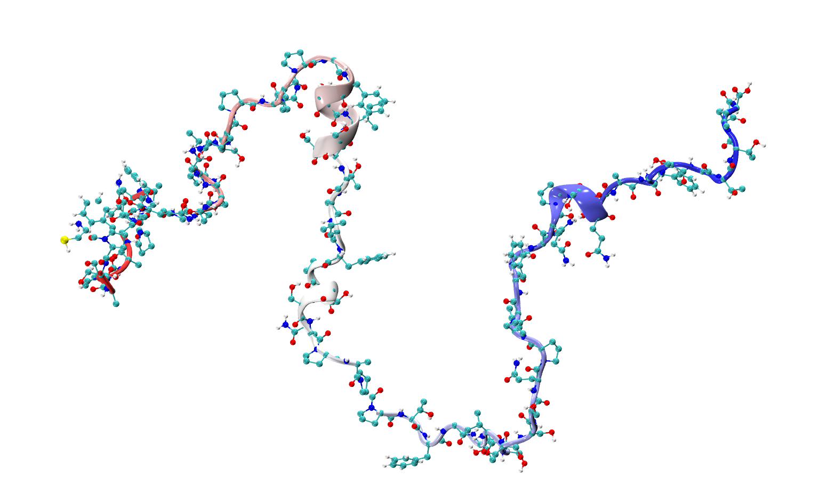
a. Representation of system’s parts
embedded in a high-dimensional configuration space
The strings of beads model
Configuration/phase space describing system's coordinates and moments: 𝑥 ∈ ℛ^{𝒹}
Dimensionality reduction by coarse-graining: ~10⁸ atoms → ~10⁴ particles
Timney*, Raveh* et al., 2016, Journal of Cell Biology
Kim et al., Nature 2018
Raveh et al. 2019, manuscript in preparation

Slide 17
a. Representation of system’s parts
embedded in a high-dimensional configuration space
The strings of beads model
Configuration/phase space describing system's coordinates and moments: 𝑥 ∈ ℛ^{𝒹}
Dimensionality reduction by coarse-graining: ~10⁸ atoms → ~10⁴ particles
Timney*, Raveh* et al., 2016, Journal of Cell Biology
Kim et al., Nature 2018
Raveh et al. 2019, manuscript in preparation

Slide 18
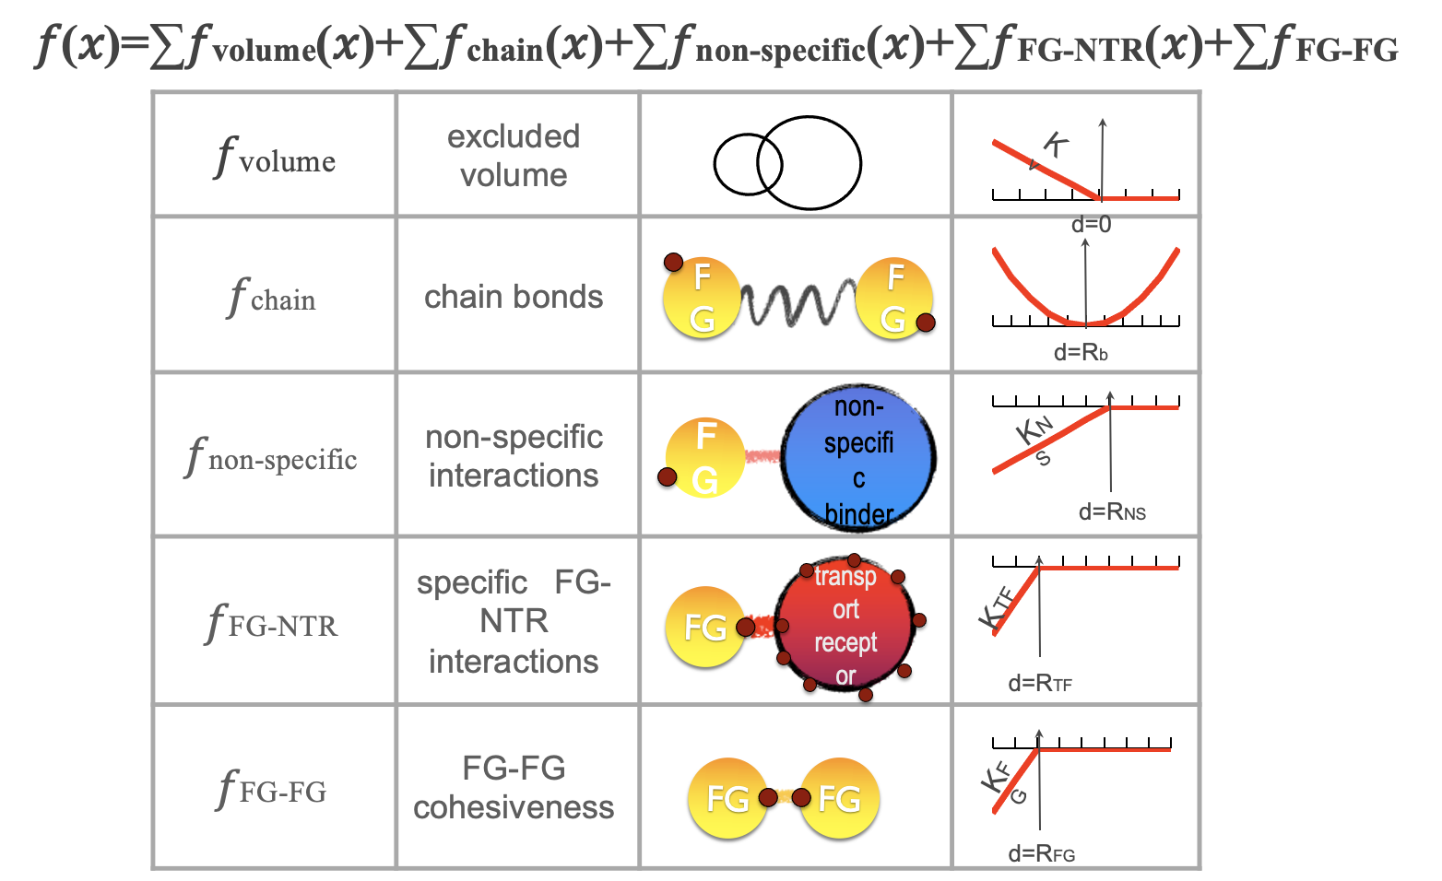
b. Representation of system’s interactions: sum of force vectors acting on system’s parts (parametrized to fit the data)
FG Nups:
cargo- carrying NTRs:
inert proteins:

Slide 19
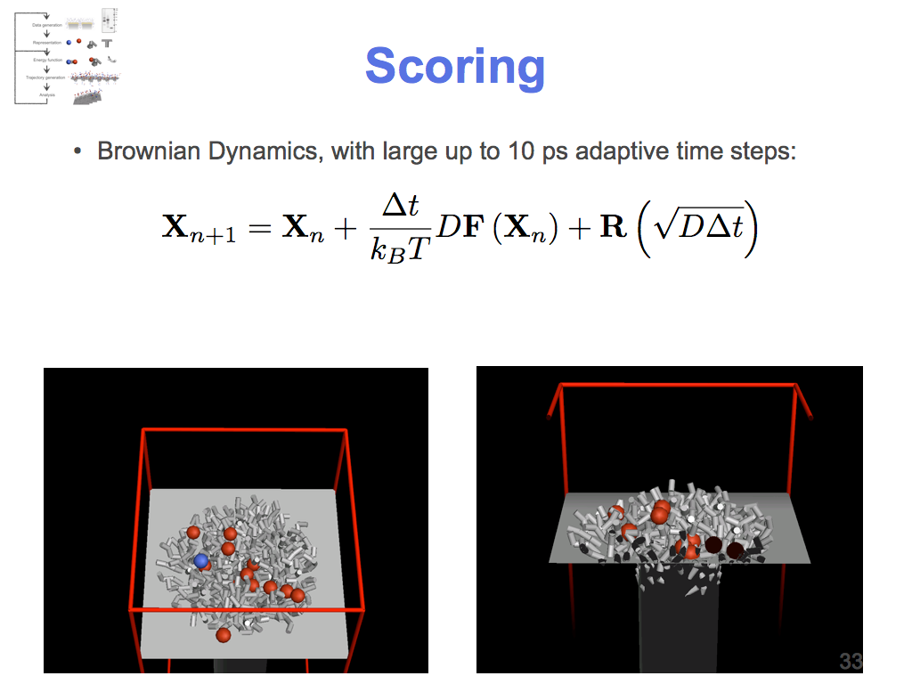
c. Representation of system’s dynamics: Brownian dynamics (a random walk in the force field’s energy landscape)
𝑓
Xn particle configuration at time step n
𝑓(Xn) sum of all forces acting on particle
R random diffusion vector
D diffusion coefficient
∆t time step
deterministic
𝑓(𝑥0)
𝑓(𝑥0)+R
X0
R
stochastic

Slide 20
Result: simulation of enormous system becomes feasible
cytoplasm
Computational challenge:
10⁷s of atoms
10⁸s of water molecules
nucleus

Slide 21
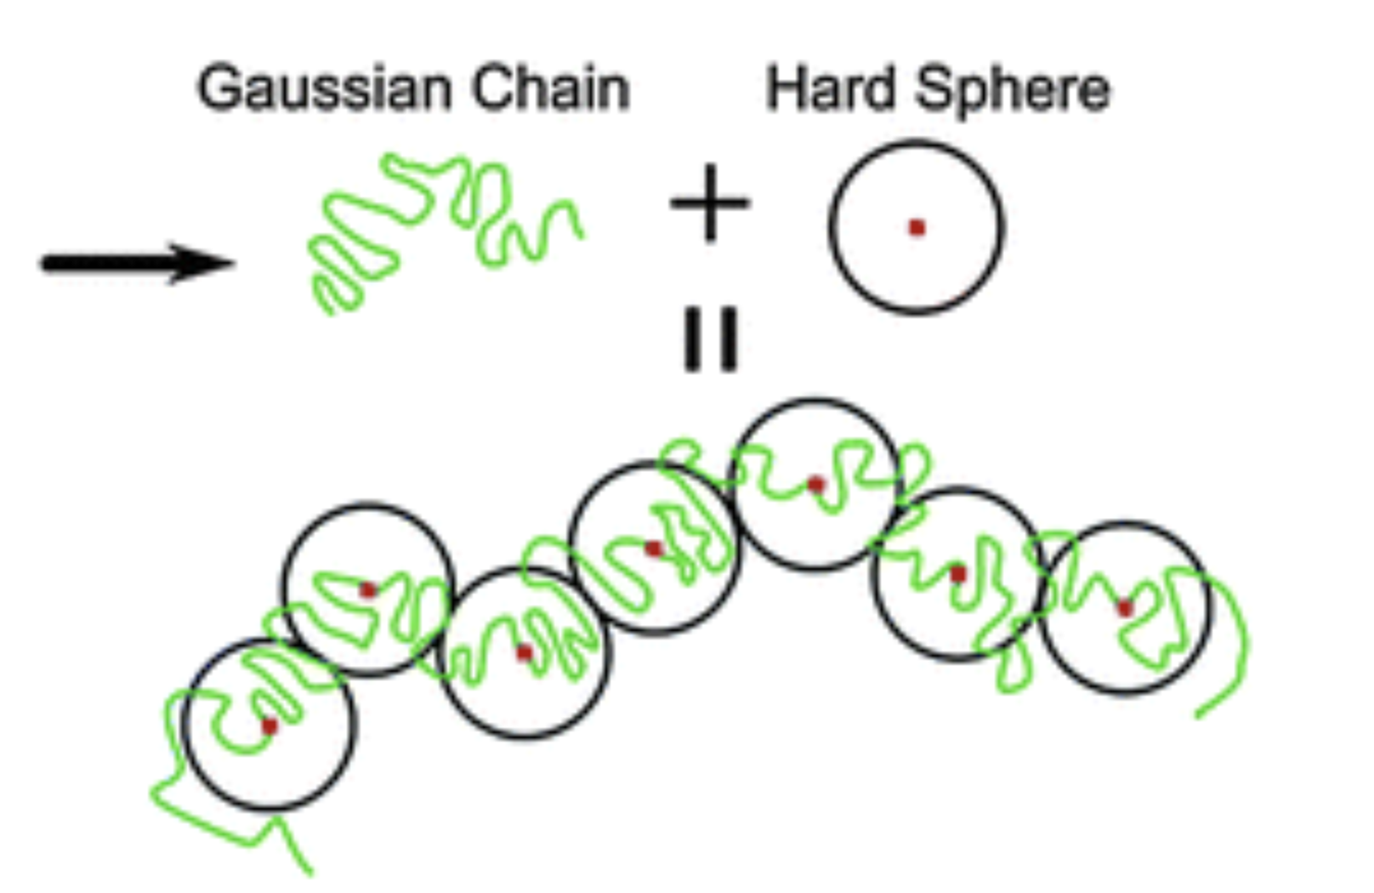
Theory for string of beads model – random walk all over again

